Slide 1
CS 4900 Project Week 3
Group: 6
Michael Hayes
Ryan Slaybaugh
Semira Pinder

Slide 2
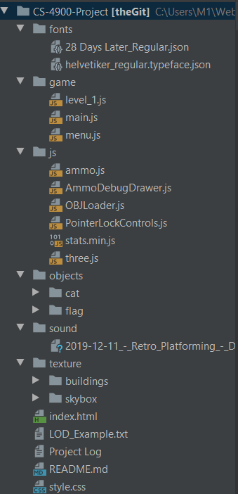
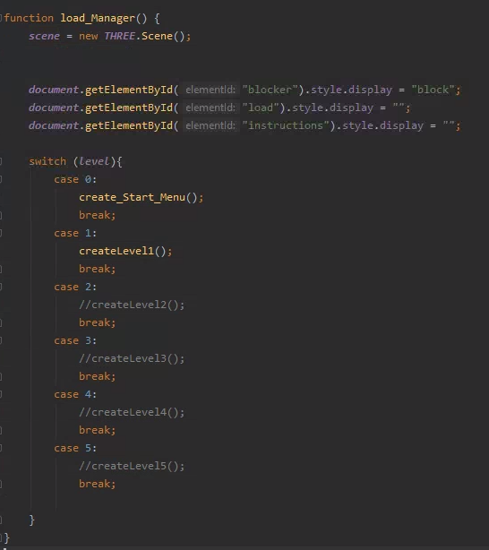
Refactoring
Global variables and renderer are kept in main.
System controls(Player movement/events) remain in main.
Every level is moved to their own javascript file.
Decreases chances of merging conflicts.

Slide 3

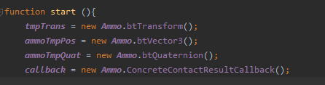
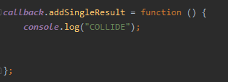
Collision Triggers
Set a global variable
In Ammo start() create new ConcreteContactResultCallback object.
Set the addSingleResult variable of callback to be a function.
This function will be the event trigger when callback is called with contactPairTest.

Slide 4

Collision Mask
When adding the physics body to the physics world you can add a group and mask.
The group is what collision group it is in and the mask is what that group can collide with.

Slide 5
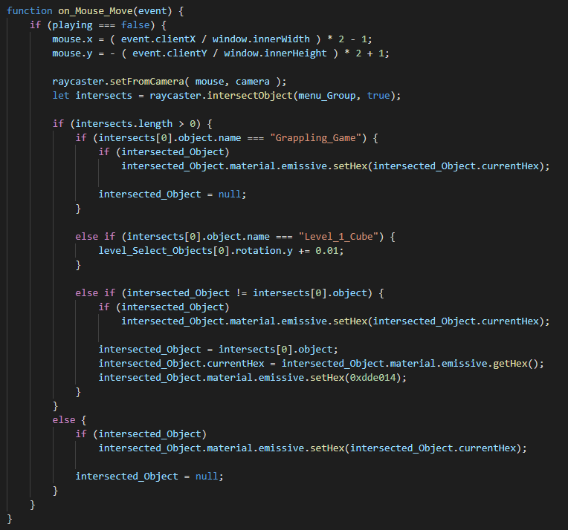
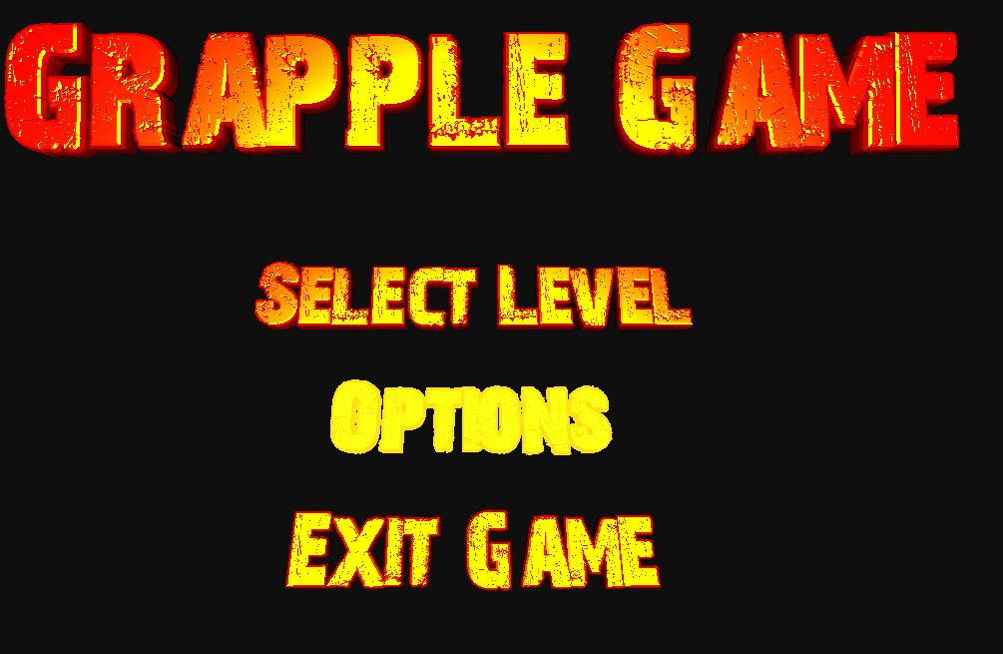
Menu Highlighting

Slide 6
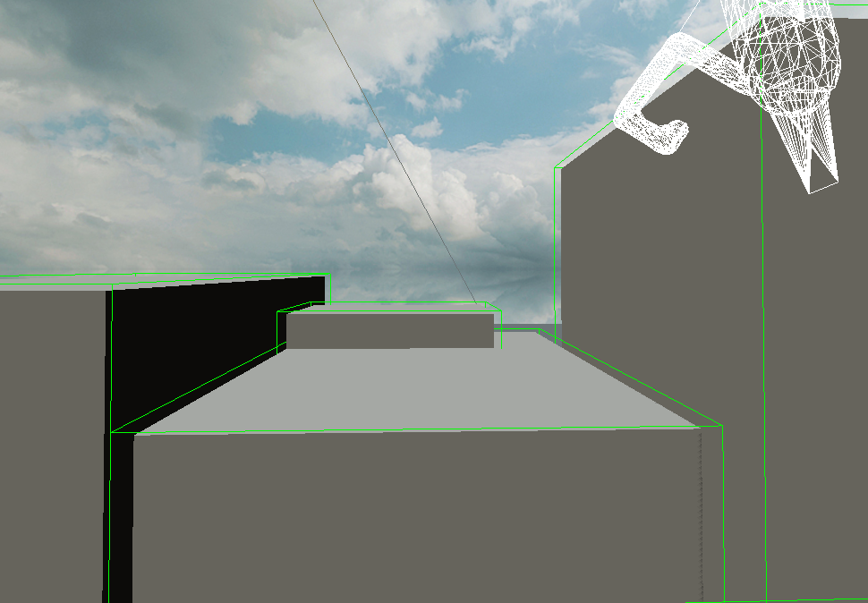
Level Design
Tricky and time consuming
Requires forward planning
Time Management

Slide 7
Animation
Walking, shooting and jumping animations

Slide 8
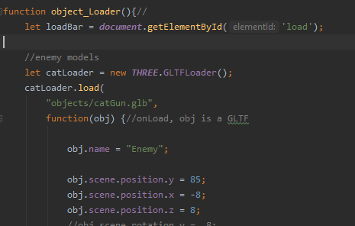
GLTF Loader
Visual bug fixed with the new file

Slide 9
Next week...
Add more animations, then import animations to the game
Create level 1
Leve timer
Level complete trigger event

